Slide 1

Fake-News
Detection
By
Sreyashee Jena

Slide 2
Problem Statement :
• The authenticity of Information has become a longstanding issue affecting businesses and society, both for printed and digital media. On social networks, the reach and effects of information spread occur at such a fast pace and so amplified that distorted, inaccurate, or false information acquires a tremendous potential to cause real-world impacts, within minutes, for millions of users. Recently, several public concerns about this problem and some approaches to mitigate the problem were expressed.
• In this project, using various model we must build a model which able to predict whether the news is real or fake.

Slide 3


Slide 4

Data Description :
There are 6 columns in the dataset provided to you. The description of each of the column is given below :
• “id”: Unique id of each news article
• “headline”: It is the title of the news.
• “news”: It contains the full text of the news article
• “Unnamed:0”: It is a serial number
• “written_by”: It represents the author of the news article
• “label”: It tells whether the news is fake (1) or not fake (0).

Slide 5

Data Cleaning
• For Data Cleaning, there are 2 features in the dataset “unnamed” and “id” which are not playing an important role for the model building, so I removed them from the dataset.
• Also, while doing text pre-processing, I used TFIDF vectorizer and count vectorizer, in which I used most important 5000 features from the dataset.

Slide 6

Creating Model
For solving this project I used various model like Logistic Regression, SVM, Random Forest etc.
For text preprocessing I used TFIDF .
Also used hyperparameter tunning and calculate the scoresand select the best model from all.

Slide 7
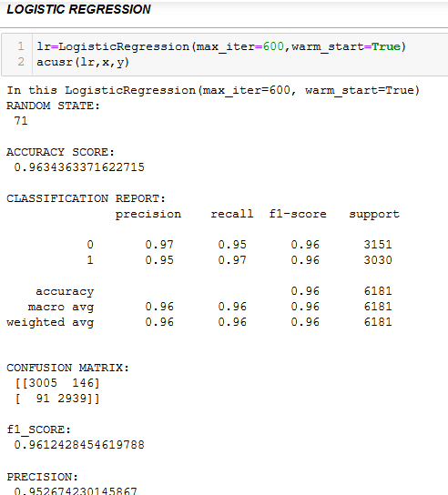
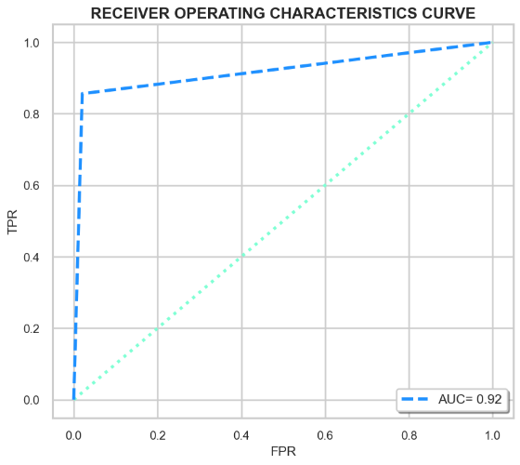
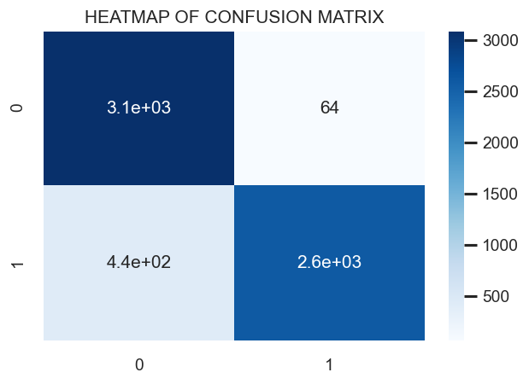
Metrics : Accuracy,
Confusion Matrix
• Logistic Regression providing the best result among all.
• For text preprocessing TFIDF providing the best result then count vectorizer.

Slide 8
Conclusion
There are various aspect of the dataset and observation from my point of view:
• There are more than 50% news that are real.
• Most of the real news are containing words followed by election, president etc.
• Removing the column that are unnamed and id does not impact the model training.
• Also, using tfidf vectorizer along with hyper parameter tuning reduce the false positive error.
• Using the roc_auc_curve most of the region fall under the curve and accuracy is more than 90%.
• From multiple models, Logistic Regression have better performance as compare to others.

Slide 9


